Slide 1

Week 2.Introduction to Python
Data Preprocessing Program
Shakhnoza Muksimova
11.09.2025

Slide 2

History of Python
Guido van Rossum, a Dutch computer scientist at the Netherlands’ National Research Center for Mathematics and Computer Science, created the Python programming language in the late 1980s. Python, first introduced in 1991, was created to be a general-purpose programming language that required little time to learn.

Slide 3
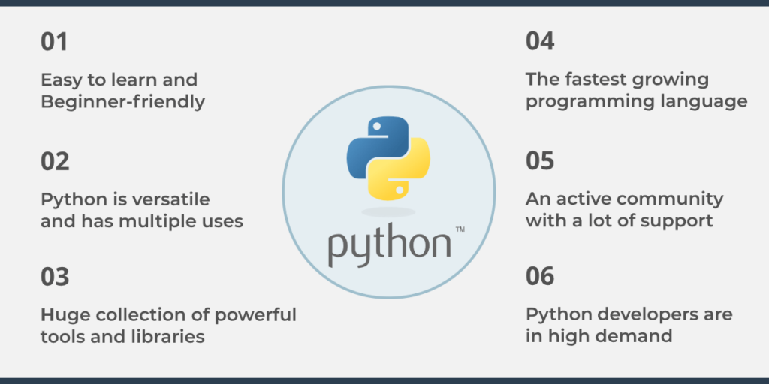
Why should we learn Python?

Slide 4
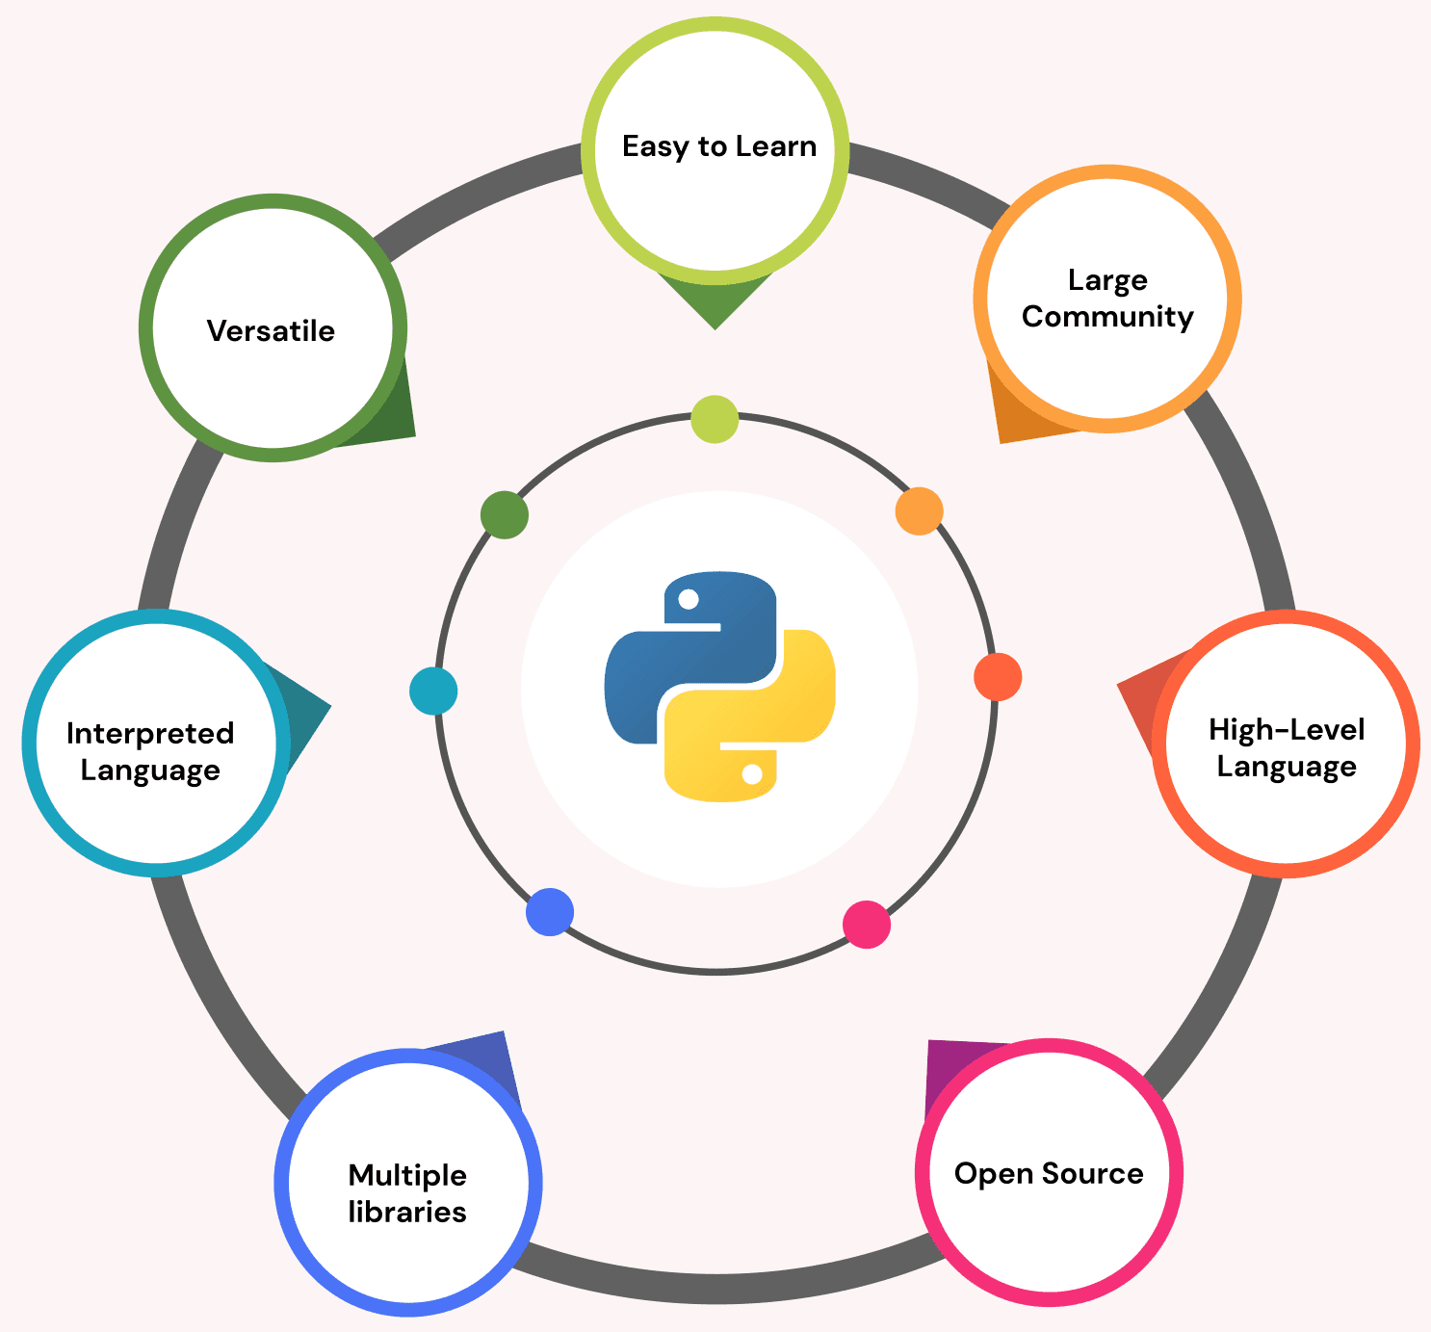
WHY USE PYTHON?

Slide 5
Python is widely used because:
It is easier to read 📖, write ✍️, and has shorter code 💻 compared to languages like C++ or Java.
It supports multiple programming paradigms , including object-oriented ⭕, imperative 📌, functional, and procedural programming.
It has extensive support libraries 📚 such as Django 🕸️ for web development and Pandas 🐼 for data analytics.
It is a dynamically typed language , meaning that the data type is based on the value assigned.
It follows the philosophy that "simplicity is the best" ✨.

Slide 6
Python versions
Python was first released on February 20, 1991 and later on developed by Python Software Foundation.
Major Python versions are – Python 1, Python 2 and Python 3.
On 26th January 1994, Python 1.0 was released.
On 16th October 2000, Python 2.0 was released with many new features.
On 3rd December 2008, Python 3.0 was released with more testing and includes new features.
Latest version - On 7nd September 2024, Python 3.13 was released.

Slide 7
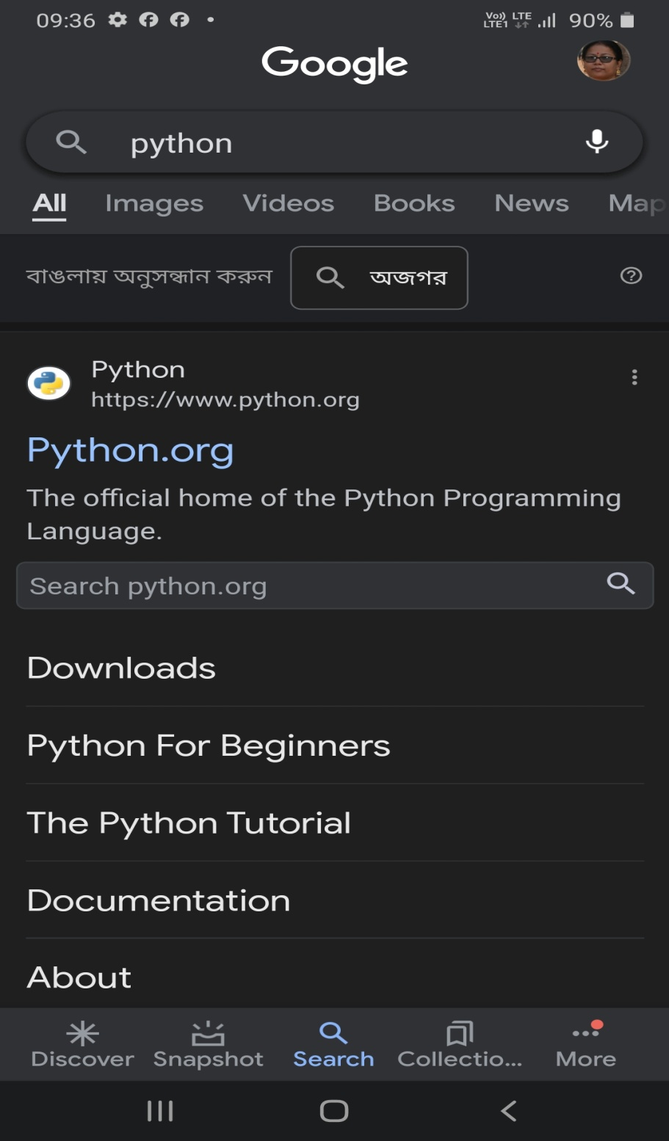

Searching for
Python

Slide 8
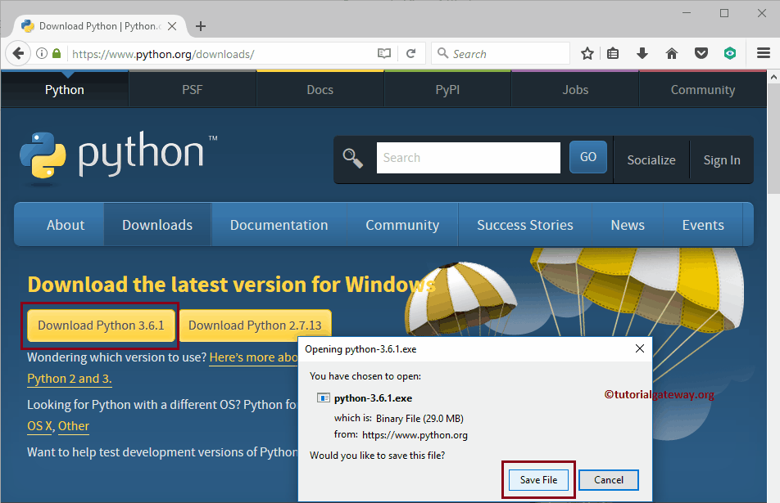
Download and Install Python

Slide 9
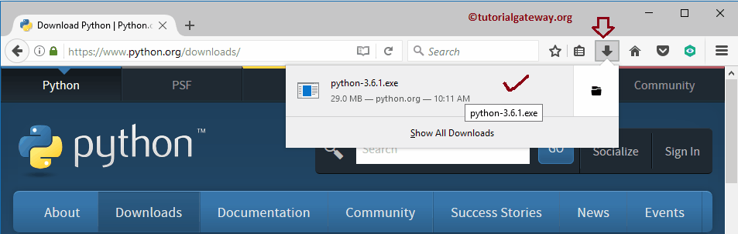
Step 1: Select the exe file

Slide 10
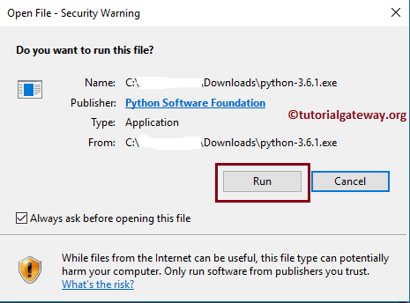
Step 2: Hit the Run button

Slide 11
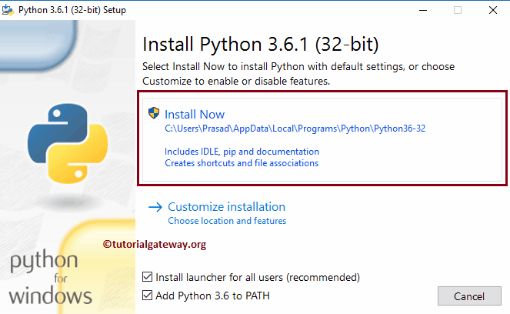
Step 3: Select Install Now

Slide 12
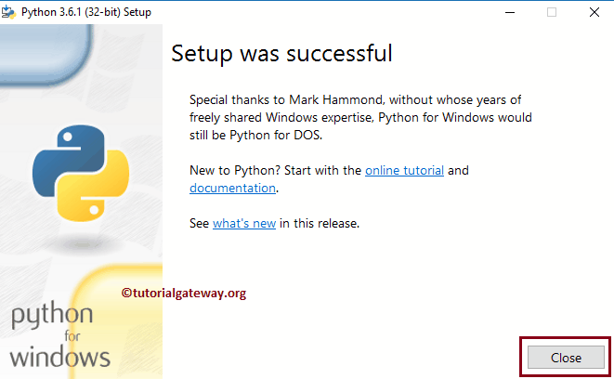
Installation process

Slide 13

Python Interpreter
A Python interpreter is a program that reads Python code and executes it line by line. When you write a Python script and run it, the interpreter reads the code, translates it into machine-readable bytecode, and then executes the bytecode. This process happens in real time, which means you can see the results of your code immediately after running it.
Here's a simple example of how to use the Python interpreter:
# Open a terminal or command prompt
# Type "python" and press enter
# You should see the Python interpreter prompt (>>>)
Python
>>> print("Hello, World!")

Slide 14
Python IDLE
Python interpreter is embedded in a number of larger programs that make it particularly easy to develop Python programs. Such a programming environment is IDLE
( Integrated Development and Learning Environment).
It is available freely online. For Windows machine IDLE (Integrated Development and Learning Environment) is installed when you install Python.

Slide 15
Running Python
There are two modes for using the Python interpreter:
Interactive Mode
Script Mode
Options for running the program:
• In Windows, you can display your folder contents, and double click on madlib.py to start the program.
• In Linux or on a Mac you can open a terminal window, change into your python directory, and enter the command python madlib.py

Slide 16
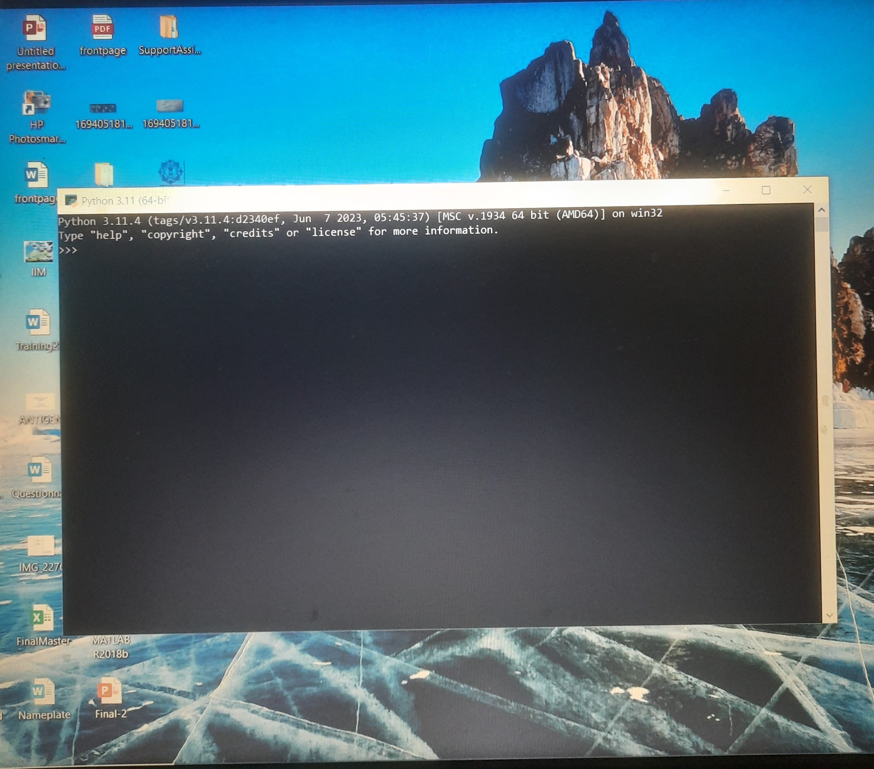
Interactive shell

Slide 17
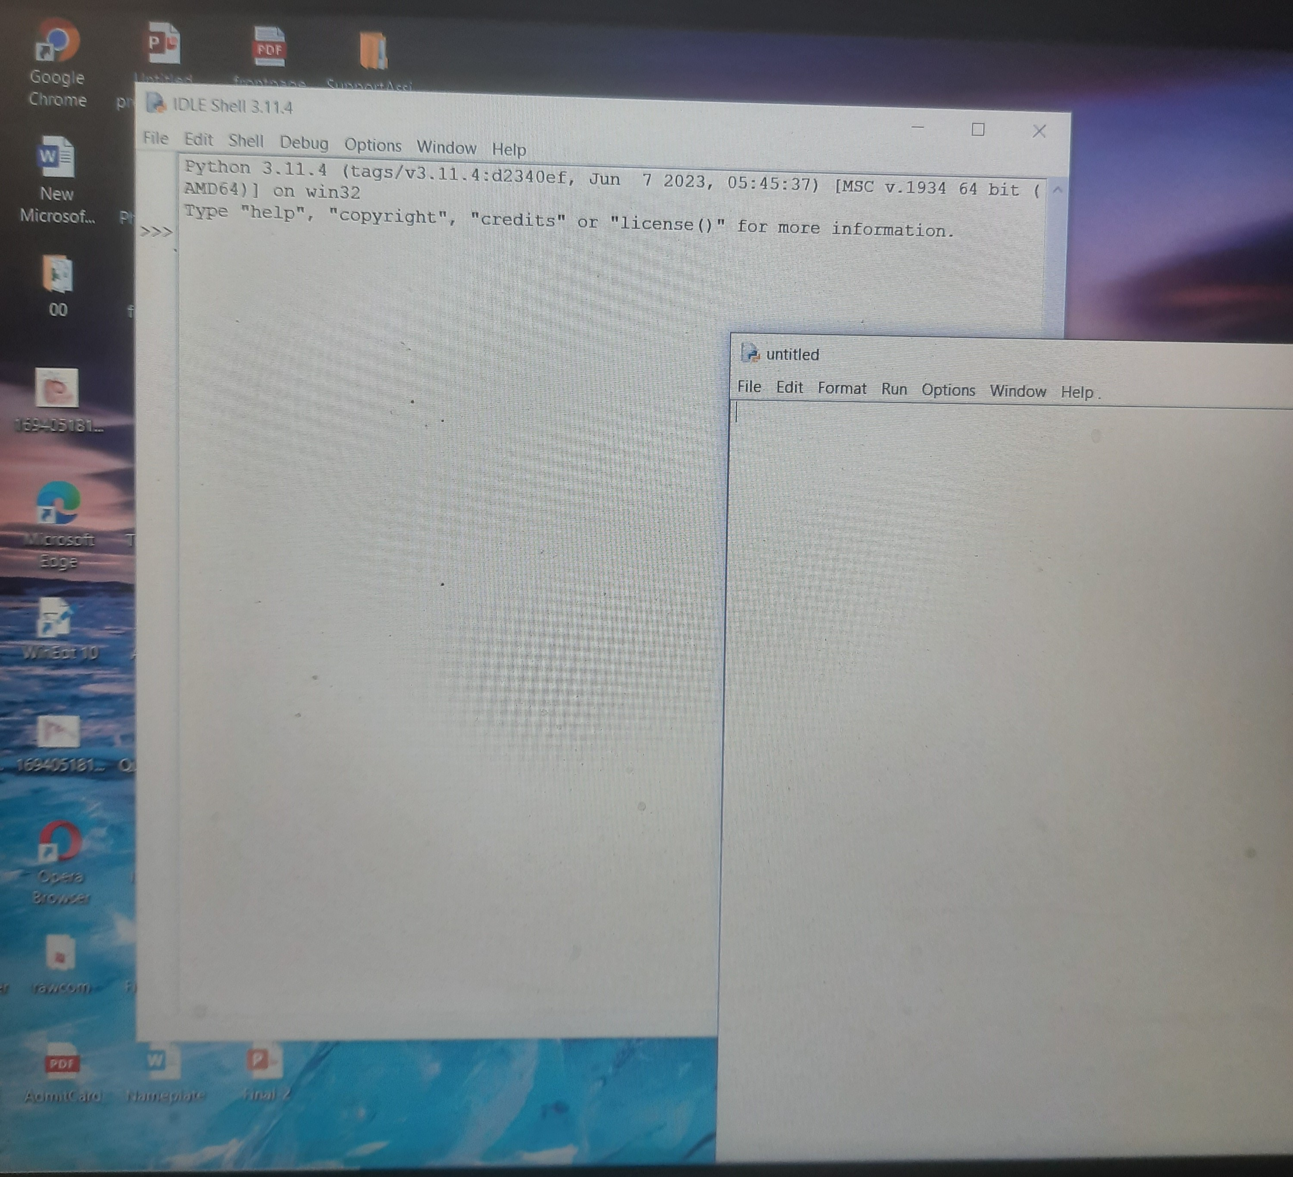
IDLE shell

Slide 18
Running Python
in interactive mode:
>>> print("Hello Teachers")
Hello Teachers
>>> a=10
>>> print(a)
10
>>> x=10
>>> z=x+20
>>> z
30

Slide 19
Running Python
2) in script mode:
Programmers can store Python script source code in a file with the .py extension, and use the interpreter to execute the contents of the file.
For UNIX OS to run a script file MyFile.py you have to type:
python MyFile.py

Slide 20
Data Types
Python has various standard data types:
Integer [ class ‘int’ ]
Float [ class ‘float’ ]
Boolean [ class ‘bool’ ]
String [ class ‘str’ ]

Slide 21
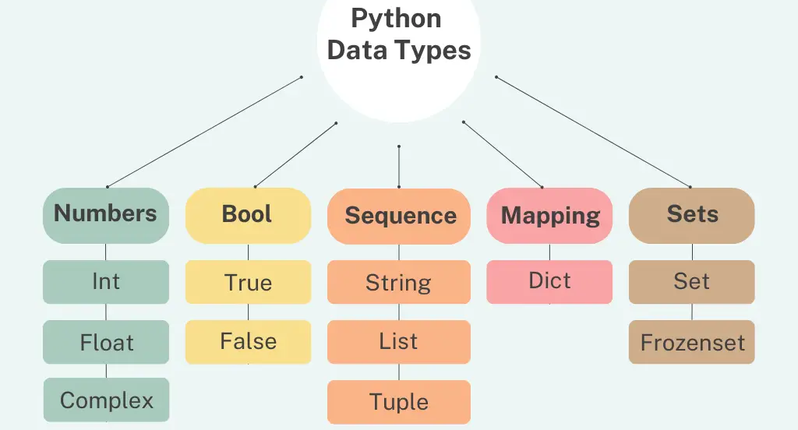

Slide 22
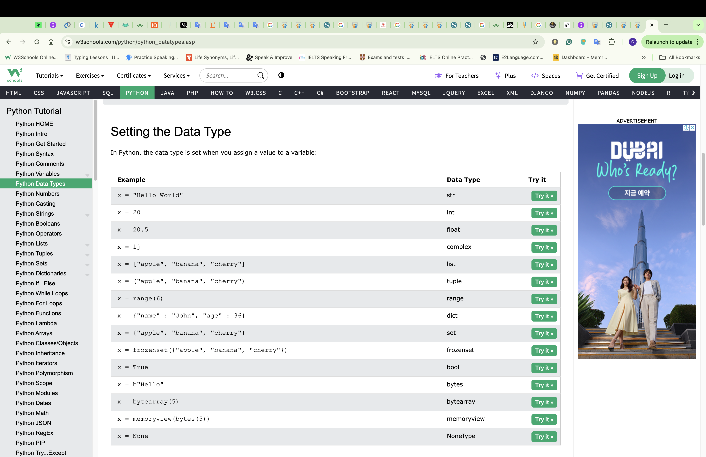
Setting the Data Type

Slide 23
Python-Numbers
Number data types store numeric values.
They are immutable data types, means that changing the value of a number data type is not possible.
For example −
var1 = 1
var2 = 10
You can also delete the reference to a number object by using the del statement.
Del var1

Slide 24
Python-Numbers
Python supports four different numerical types −
int (signed integers) − They are often called just integers or ints, are positive or negative whole numbers with no decimal point.
Long (long integers ) − Also called longs, they are integers of unlimited size, written like integers and followed by an uppercase or lowercase L.
float (floating point real values) − Also called floats, they represent real numbers and are written with a decimal point dividing the integer and fractional parts.
complex (complex numbers) − are of the form a + bJ, where a and b are floats and J (or j) represents the square root of -1 (which is an imaginary number).

Slide 25
Number Type Conversion
But sometimes, you need to convert a number explicitly from one type to another to satisfy the requirements of an operator or function parameter.
Type int(x) to convert x to a plain integer.
Type long(x) to convert x to a long integer.
Type float(x) to convert x to a floating-point number.
Type complex(x) to convert x to a complex number with real part x and imaginary part zero.
Type complex(x, y) to convert x and y to a complex number with real part x and imaginary part y. x and y are numeric expressions

Slide 26
Strings
Strings are amongst the most popular types in Python.
We can create them simply by enclosing characters in quotes. Python treats single quotes the same as double quotes.
var1 = 'Hello World!‘
var2 = "Python Programming"

Slide 27
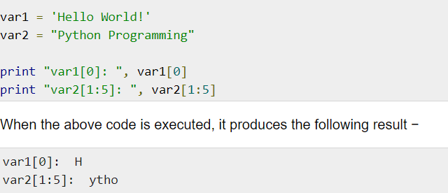
Accessing Values in Strings
Python does not support a character type; these are treated as strings of length one, thus also considered a substring.
To access substrings, use the square brackets for slicing along with the index or indices to obtain your substring.

Slide 28
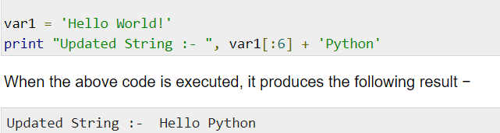
Updating Strings
You can "update" an existing string by (re)assigning a variable to another string. The new value can be related to its previous value or to a completely different string altogether.

Slide 29
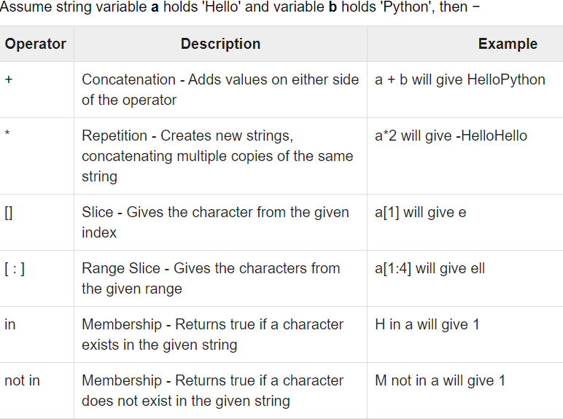
String Special Operators

Slide 30
Python Lists
Lists are the most versatile of Python's compound data types.
A list contains items separated by commas and enclosed within square brackets ([]).
To some extent, lists are similar to arrays in C.
One difference between them is that all the items belonging to a list can be of different data type.

Slide 31
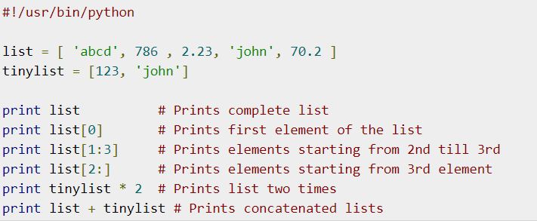
Python Lists

Slide 32
Python Tuples
A tuple is another sequence data type that is similar to the list.
A tuple consists of a number of values separated by commas.
Unlike lists, however, tuples are enclosed within parentheses.
The main differences between lists and tuples are: Lists are enclosed in brackets ( [ ] ) and their elements and size can be changed,
while tuples are enclosed in parentheses ( ( ) ) and cannot be updated.
Tuples can be thought of as read-only lists.

Slide 33
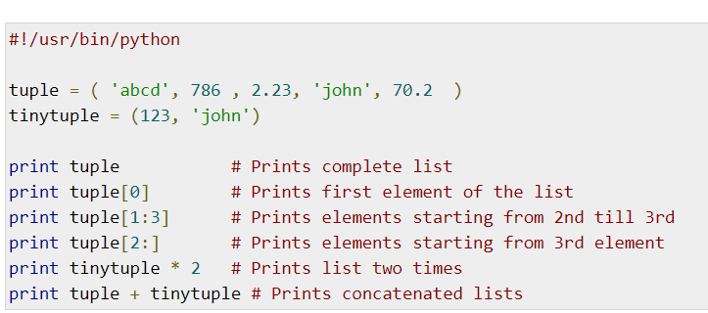
Python Tuples

Slide 34
Python Dictionary
A Python dictionary is a mapping of unique keys to values. Dictionaries are mutable, which means they can be changed.
Dictionaries are enclosed by curly braces ({ }) and values can be assigned and accessed using square braces ([]).

Slide 35
Dictionary Functions
Len-The method len() gives the total length of the dictionary.
dict = {'Name': 'Zara', 'Age': 7};
print (len(dict))
Copy-The method copy() returns a shallow copy of the dictionary.
dict1 = {'Name': 'Zara', 'Age': 7};
dict2 = dict1.copy()
print "New Dictionary : %s" % str(dict2)

Slide 36
Keys-The method keys() returns a list of all the available keys in the dictionary.
my_dict = {'name':'Jack', 'age': 26}
print "Value : %s" % dict.keys()
Values-The method values() returns a list of all the values available in a given dictionary.
print "Value : %s" % dict.values()

Slide 37
Set in Python
A set is an unordered collection of items.
Every element is unique (no duplicates) and must be immutable (which cannot be changed).
my_set = {1, 2, 3}
print(my_set)

Slide 38
Change a set in Python
Sets are mutable. But since they are unordered, indexing have no meaning.
We can add single element using the add() method and multiple elements using the update() method.
The update() method can take tuples, lists, strings or other sets as its argument. In all cases, duplicates are avoided.

Slide 39
Remove elements from a set
A particular item can be removed from set using methods, discard() and remove().
The only difference between the two is that, while using discard() if the item does not exist in the set, it remains unchanged.
But remove() will raise an error in such condition.
my_set.discard(4)
print(my_set)
my_set.remove(4)

Slide 40
Integer
Int:
For integer or whole number, positive or negative, without decimals of unlimited length.
>>> print(2465635468765)
2465635468765
>>> print(0b10) # 0b indicates binary number
2
>>> print(0x10) # 0x indicates hexadecimal number
16
>>> a=11
>>> print(type(a))
<class 'int'>

Slide 41
Float
Float:
Float, or "floating point number" is a number, positive or negative. Float can also be scientific numbers with an "e" to indicate the power of 10.
>>> y=2.8
>>> y
2.8
>>> print(0.00000045)
4.5e-07
>>> y=2.8
>>> print(type(y))
<class 'float'>

Slide 42
Boolean and String
Boolean:
Objects of Boolean type may have one of two values, True or False:
>>> type(True)
<class 'bool'>
>>> type(False)
<class 'bool'>
String:
>>> print(‘Science college’)
Science college
>>> type("My college")
<class 'str'>

Slide 43
Variables
One can store integers, decimals or characters in variables.
Rules for Python variables:
• A variable name must start with a letter or the underscore character
• A variable name cannot start with a number
• A variable name can only contain alpha-numeric characters and underscores (A-z, 0-9, and _ )
• Variable names are case-sensitive (age, Age and AGE are three different variables)
a= 100 # An integer assignment
b = 1040.23 # A floating point
c = "John" # A string

Slide 44
print function
>>>type(print)
Output:
builtin_function_or_method
>>>print( ‘Good morning’ ) or print(“Good morning”)
Output:
Good morning
>>>print(“Workshop”, “on”, “Python”) or print(“Workshop on Python”)
Output:
Workshop on Python

Slide 45
print function
>>>print(‘Workshop’, ‘on’, ‘Python’, sep=’\n’)
# sep=‘\n’ will put each word in a new line
Output:
Workshop
on
Python
>>>print(‘Workshop’, ‘on’, ‘Python’, sep=’, ’)
# sep=‘, ’ will print words separated by ,
Output:
Workshop, on, Python

Slide 46
print function
int_list = [1, 2, 3, 4, 5]
print(int_list) # printing a list
Output: [1, 2, 3, 4, 5]
my_tuple = (10, 20, 30)
print(my_tuple) # printing a tuple
Output: (10, 20, 30)
my_dict = {“language”: “Python”, “field”: “data science”}
print(my_dict) # printing a dictionary
Output: {“language”: “Python”, “field”: “data science”}
my_set = {“red”, “yellow”, “green”, “blue”}
print(my_set) #printing a set
Output: {“red”, “yellow”, “green”, “blue”}

Slide 47
print function
str1 = ‘Python code’
str2 = ‘Matlab code’
print(str1)
print(str2)
Output: Python code
Matlab code
print(str1, end=’ ‘)
print(str2)
Output: Python code Matlab code
print(str1, end=’, ‘)
print(str2)
Output: Python code, Matlab code

Slide 48
print function
items = [ 1, 2, 3, 4, 5]
for item in items:
print(item)
Output:
1
2
3
4
5
items = [ 1, 2, 3, 4, 5]
for item in items:
print(item, end=’ ‘)
Output:
1 2 3 4 5

Slide 49
Operators
Addition + Subtraction -
Multiplication * Exponentiation **
Division / Integer division / /
Remainder %
Binary left shift << Binary right shift >>
And & Or |
Less than < Greater than >
Less than or equal to <= Greater than or equal to >=
Check equality == Check not equal !=

Slide 50
Precedence of Operators
Examples:
a = 20
b = 10
c = 15
d = 5
e = 2
f = (a + b) * c / d
print( f)
g = a + (b * c) / d - e
print(g)
h = a + b*c**e
print(h)

Slide 51
Special Use of + and *
Examples:
x = "Python is "
y = "awesome."
z = x + y
print(z)
Output:
Python is awesome.
print(‘It is’ + 2*’very ’ + ’hot.’)
Output:
It is very very hot.

Slide 52
Use of \”, \n, \t
Specifying a backslash (\) in front of the quote character in a string “escapes” it and causes Python to suppress its usual special meaning. It is then interpreted simply as a literal single quote character:
>>> print(" \”Beauty of Flower\” ")
”Beauty of Flower”
>>> print('Red \n Blue \n Green ')
Red
Blue
Green
>>> print("a \t b \t c \t d")
a b c d

Slide 53
Comments
Single-line comments begins with a hash ( # ) symbol and is useful in mentioning that the whole line should be considered as a comment until the end of line.
A Multi line comment is useful when we need to comment on many lines. In python, triple double quote(“ “ “) and single quote(‘ ‘ ‘)are used for multi-line commenting.
Example:
“““ My Program to find. Average of three numbers ”””
a = 29 # Assigning value of a
b = 17 # Assigning value of b
c = 36 # Assigning value of c
average = ( a + b + c)/3
print(“Average value is ”, average)

Slide 54
File
A file is some information or data which stays in the computer storage devices.
Files are of two types:
text files
binary files.
Text files:
We can create the text files by using the following syntax:
Variable name = open (“file.txt”, file mode)
Example:
f= open ("hello.txt","w+“)

Slide 55
File modes
Mode | Description
‘r’ | This is the default mode. It Opens file for reading.
‘w’ | This Mode Opens file for writing. If file does not exist, it creates a new file. If file exists it truncates the file.
‘x’ | Creates a new file. If file already exists, the operation fails.
‘a’ | Open file in append mode. If file does not exist, it creates a new file.
‘t’ | This is the default mode. It opens in text mode.
‘b’ | This opens in binary mode.
‘+’ | This will open a file for reading and writing (updating) .

Slide 56
Creating output file
file = open(‘output.txt’, ‘a+’)
items = [‘mango’, ‘orange’, ‘banana’, ‘apple’]
for item in items:
print(item, file = file)
file.close()

Slide 57
# Write a python program to open and read a file
a=open(“one.txt”, ”r”)
content = a.read()
print(content)
a.close( )
# Write a python program to open and write “hello world” into a file.
f=open("file.txt","a")
f.write("hello world")
f.close( )

Slide 58
# Python program to write the content “Hi python programming” for the existing file.
f=open("MyFile.txt",'w')
f.write("Hi python programming")
f.close()
# Write a python program to open and write the content to file and read it.
f=open("abc.txt","w+")
f.write("Python Programming")
print(f.read())
f.close()

